Slide 1


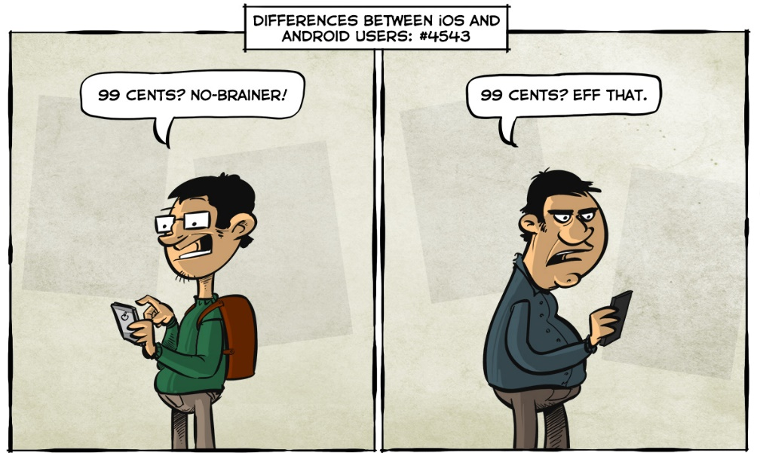
Android Mobile Applications Course Introduction
Dimitar Ivanov
Android Mobile Applications
Telerik Software Academy
http://academy.telerik.com

Slide 2
Course Objectives
Create a Android application
Create an activity and manage its lifecycle.
Access resources programmatically to optimize maintenance and localization.
Create full-featured graphical user interfaces with widget, dialogs, menus, and event handlers.
Control the organization of your screen with layouts.

Slide 3
Course Objectives
Design flexible user interfaces for multiple form factors using fragments
Communicate between applications in a loosely-coupled way with intents
Listen for notifications with broadcast receivers
Create a service to handle background tasks and use notifications to indicate the status of those tasks
Persist application state using preferences, files, and SQLLite

Slide 4
Course Objectives
Use both ArrayAdapter and CursorAdapter to bind data to widgets.
Share data with other applications with content providers.
Access Contacts and other build-in Android providers.
Determine the current location and leverage Google Maps.
Publish an application to an Android device.

Slide 5





Evaluation
Thank God There Are Bonuses!

Slide 6

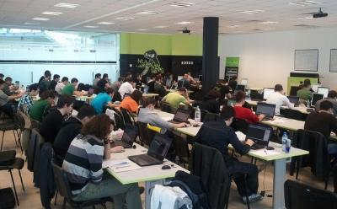
Android Mobile Apps: Evaluation
Evaluation components
Course project – 75%
Homework – 10%
Homework evaluation – 5%
3 peer reviews per homework (excellent, OK, bad)
Attendance in class – 10%
Bonuses
Forums activity – bonus up to 5%

Slide 7


Pass / Excellence / Fail Criteria
Criteria for pass / pass with excellence / fail
Pass with excellence
Very high exam results
or
High total results
Pass
Average total results
Fail
Low total results or low exam results

Slide 8
Homework Peer Reviews
Everyone will get feedback for their homework
Everyone will give feedback for few random homework submissions
Students submit homework anonymously
Please exclude your name from the submissions!
For each homework submitted
Students evaluate 3 random homeworks
From the same topic, after the deadline
Homework comments are not obligatory

Slide 9
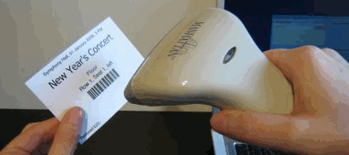
Check Your Presence
From now on you should check your presence on the barcode reader 2-3 times a day:
In the morning when lectures begin (~10:30)
After lunch break (~13:30)
When you have data structures and algorithms when the lecture starts (~18:00)

Slide 10
Course Project
The course project will consist of developing an mobile application for Android devices
In random teams of two
Should work with remote data (REST)
Should use device capabilities
More information can be found in the Project description.docx

Slide 11
Android Mobile Applications Course Introduction
http://academy.telerik.com

